Slide 1
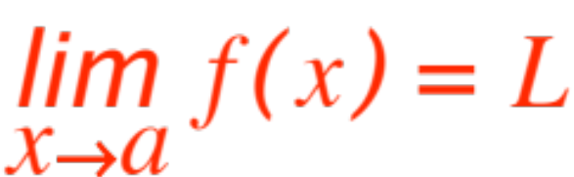
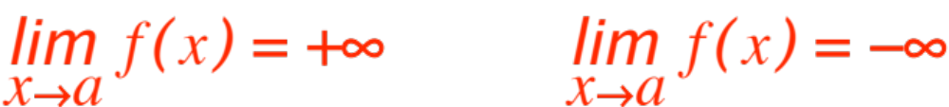
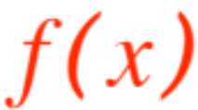



DEFINITION OF LIMIT
We are going to learn the precise definition of what is meant by the statements
and
.
We must make precise our intuitive notion that
gets arbitrarily close to as gets close to .

Slide 2
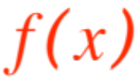

Let’s begin by noticing that gets close to
vertically
while approaches horizontally.
How do we measure closeness? Obviously by
distance
Mathematically distance is measured (in whatever unit turns us on) by “absolute values”, because the distance between South Bend and Atlanta is exactly the same as from Atlanta to South Bend. So that when we say
gets close to we mean that

Slide 3
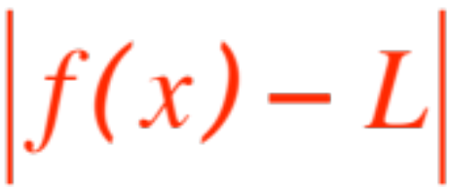
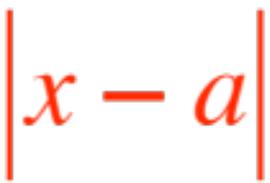

gets pretty small (vertically !) as
gets pretty small (horizontally, but not )
Of course, how small the former gets depends on how small the latter becomes.
With the accumulated wisdom of centuries we give the following
Definition. The statement means
that

Slide 4
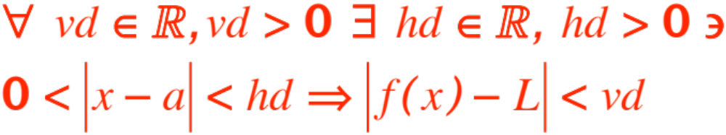


(ready?)
Some explanations are needed. First of all
stands for vertical distance and for horizontal distance. (Not what you thought!)
Your textbook uses different symbols, but it’s a free country, and once I am sure you understand what’s going on I will return to the textbook’s symbolism.

Slide 5
OK, let’s translate math language into English. If I were teaching in Outer Slobbovia the formula would still be the same, math language, but I’d be translating into Outer Slobbovian. Math language is universal, human languages are not.
God reacted to the tower of Babel and messed us up with many different human languages, but then relented when thinking of Mathematics ! ☺
In the next slide I will exhibit the formula again, then translate it into a language you can understand. Eventually I hope you will learn actually to understand math language.

Slide 6

Math
Human
For every positive real number there is
a positive real number such that
if is within of (but NOT at !) then
is within of .
Let’s translate everything into pictures ☺

Slide 7
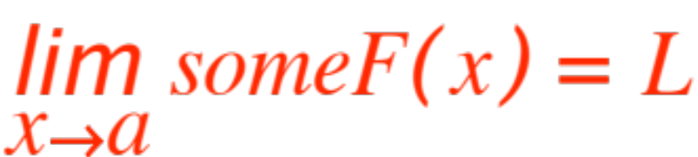

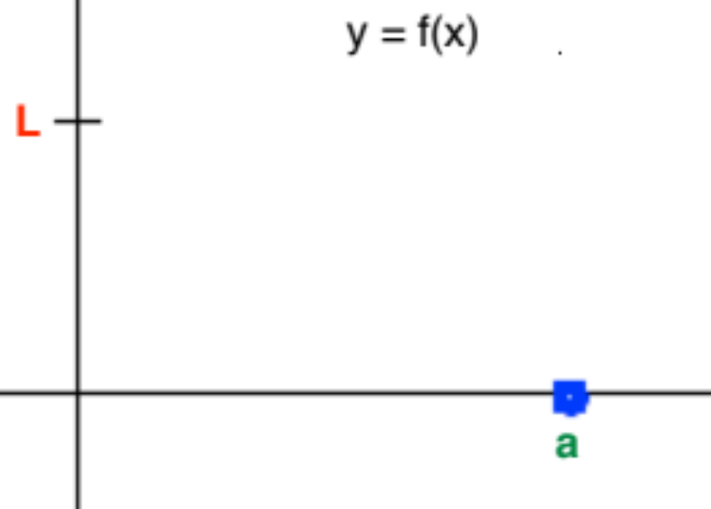

When asked to prove that
all that we really know is the values of and
and some vague idea about .

Slide 8

The next step is to choose .
Whoa! We can’t choose !
We have to do whatever we do for all positive real numbers! Your textbook suggests correctly that you think of this as a challenge, your “opponent” (that could be me! ☺ ) chooses (your opponent could be nasty!) and it’s up to you to verify the rest of the definition with the your opponent has given you. So the picture so far looks like this (remember that stands for vertical displacement)

Slide 9
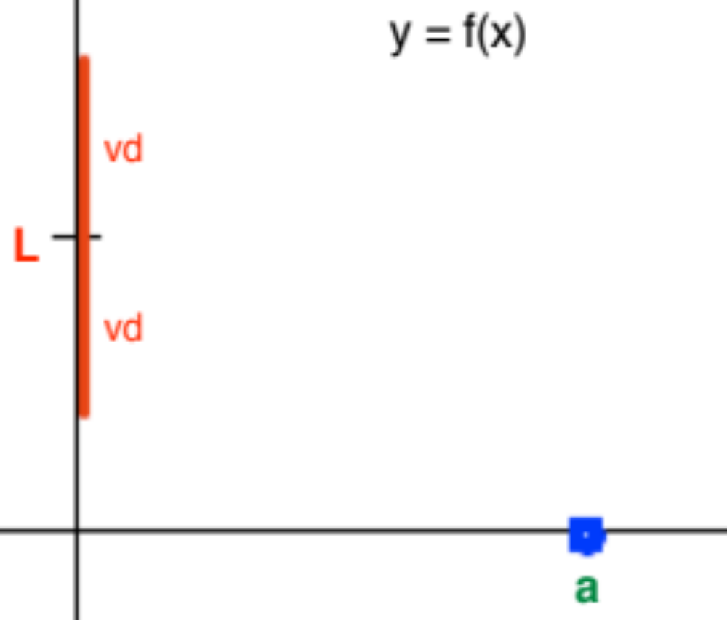
Your job is to find an that works, that is a green interval ( stands for horizontal displacement!)

Slide 10
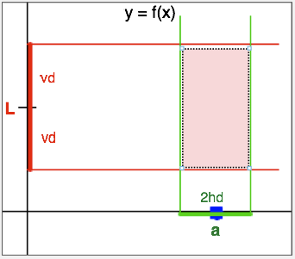
so that
when is in the green interval, is inside the resulting rectangle.

Slide 11

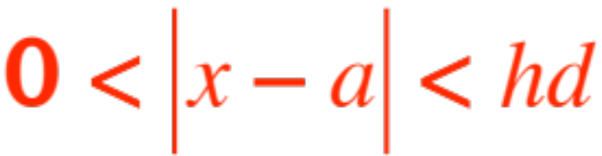
How does one find ? The phrase “there is” only requires one to exhibit one possible candidate (one moment’s reflection will convince you that if one works, anything smaller will work also!).
How does one find that one candidate? Usually one looks at the picture, or checks how is behaving near , but essentially there is no recipe for finding one reasonable ,
(dream it overnight, do some preliminary analysis, attend a séance), the point is that whatever you choose, you have to prove that it does the job, that indeed if

Slide 12
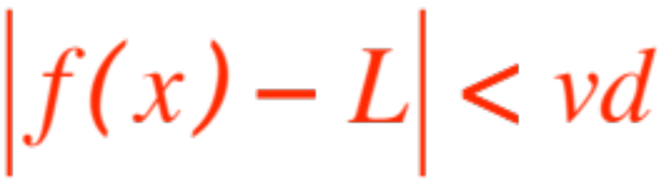

then , that is
is inside the rectangle.

Slide 13
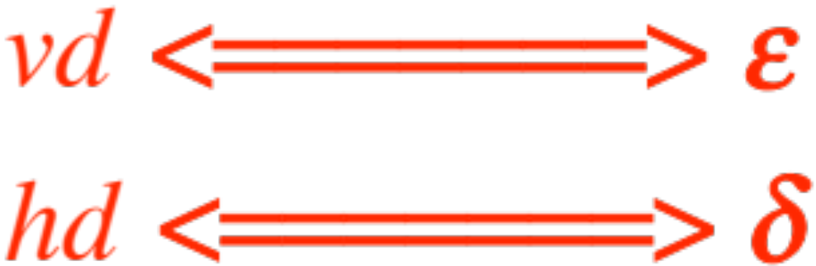
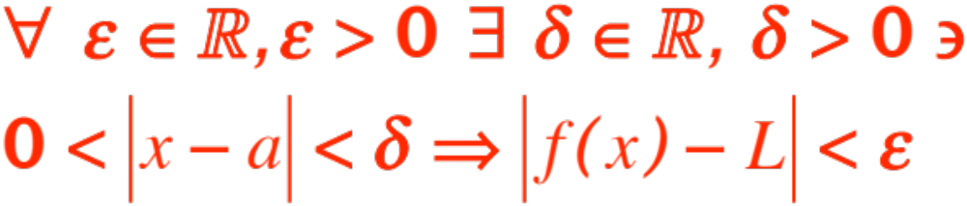
I hope that by now I can count on your under-standing of what and stand for and how they are used, so I will return to the textbook’s notation, which is indicated below:
(epsilon)
(delta) so the formal definition becomes (ready?)

Slide 14
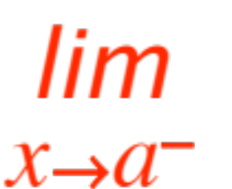

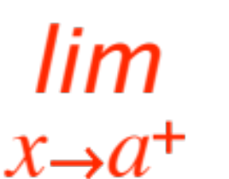

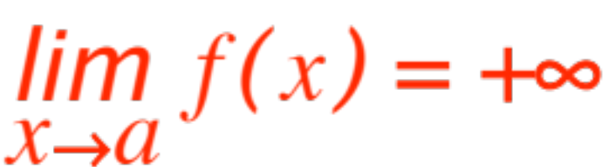
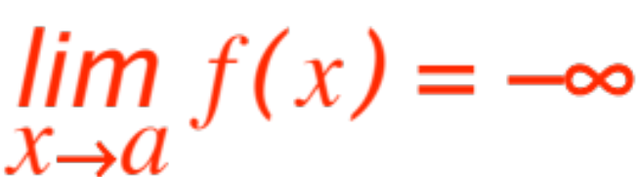
The definition can be easily modified for one-sided limits:
add for and
add for .
You should be able to modify the definition to cover the cases of
and
Now we do some examples.

Slide 15
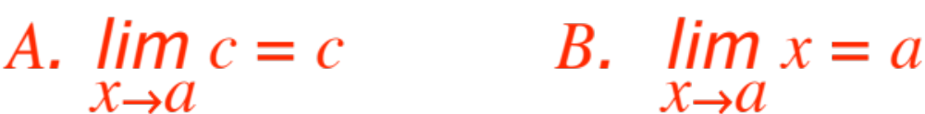
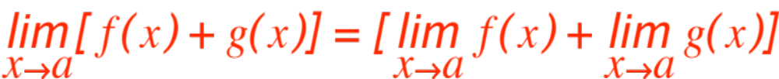


We will prove the two initial ingredients:
and the first tool
Here we go.
Let be any positive real number. For each of the three cases we choose a particular and prove that our choice works

Slide 16
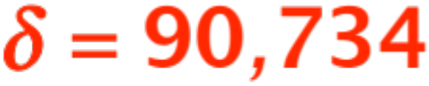
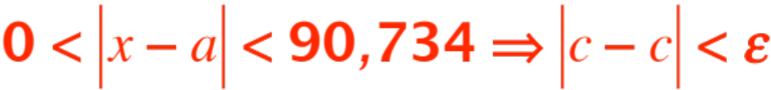

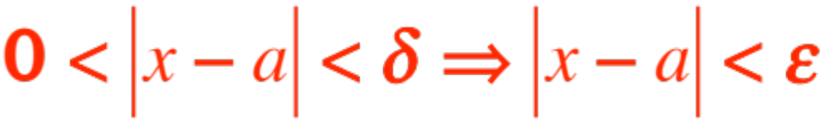

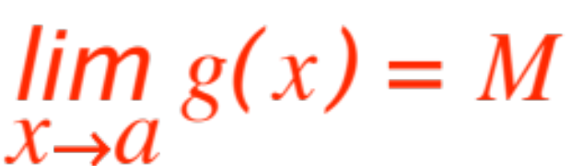
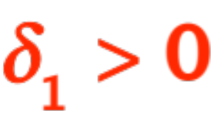
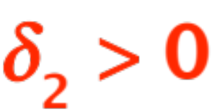
A. Choose (or any other positive real number you like). Clearly
B. Choose . Clearly
First tool. Let and
For some and we have

Slide 17
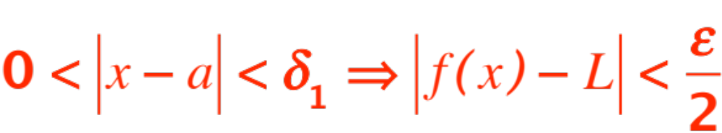
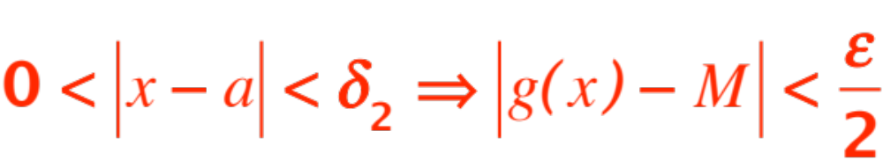
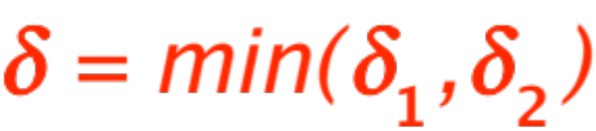
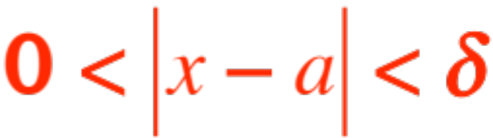
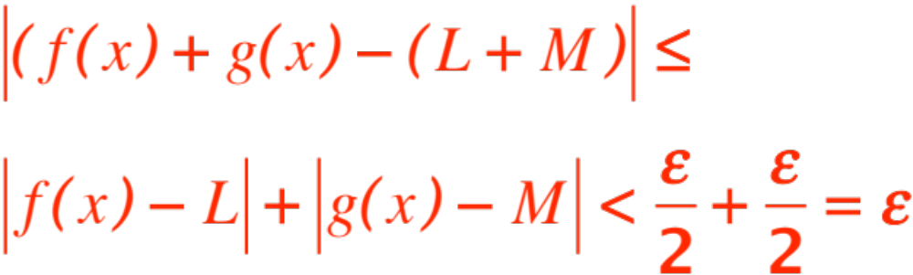
And
(Why?) Choose
Then implies that

Slide 18
Now we do exercises. (You read the text)
From pp. 80, 81
11
13
21
34
38
41

